Slide 1



Business Pitch for
BookBridge
By: SE-S1-WD-11

Slide 2


Overview
Introduction
01
What is BookBridge
02
What we can do in BookBridge
03
Benefits we can gain from BookBridge
04

Slide 3


Introduction
We are going to give a brief introduction of our newly created app called
“BookBridge”
book donation app
We will discuss what is the target audience, how the application works
and
what are the benefits that we will gain
01

Slide 4

What is BookBridge
BookBridge is a mobile application for book donations.
BookBridge is a solution for making stability of the schools and education enhancement.
Book donations can be done through hand on or purchasing.
BookBridge is focusing on financially unstable schools and students.
02

Slide 5
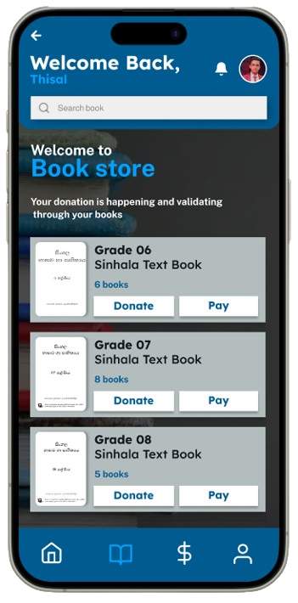
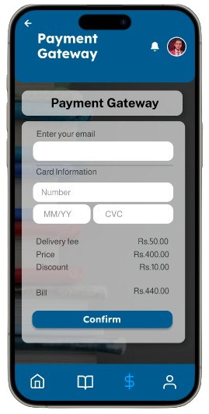
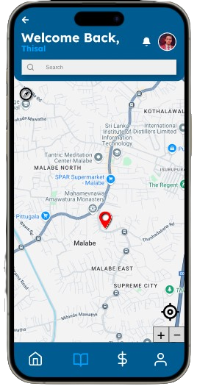
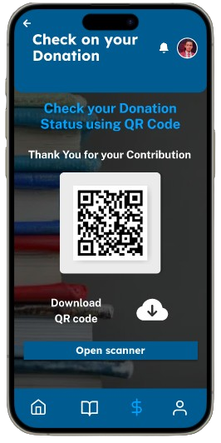
What we can do in BookBridge
Donate book by hand-on donation and purchasing
Purchase book through online pay for donation
Search the nearest collection center through map
Generate QR to check the book donation status
03

Slide 6
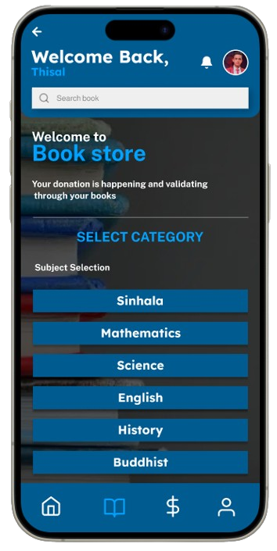
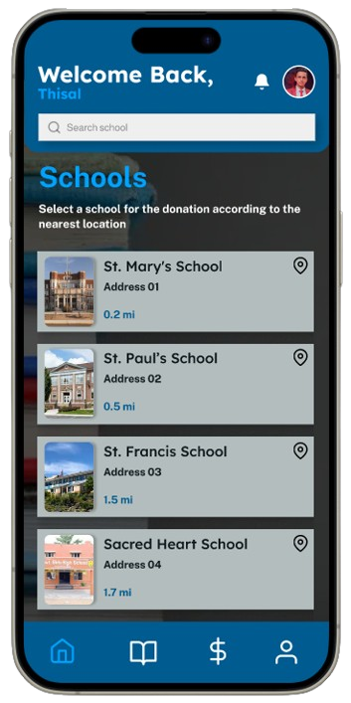
01
Enhance the education and schools
02
Less time consuming
Benefits
We can gain
From
BookBridge
03
Environmental Impact
04
Secured book donation
04
Secured payment gateway
04

Slide 7


THANK YOU!
ANY QUESTIONS?

Slide 8





































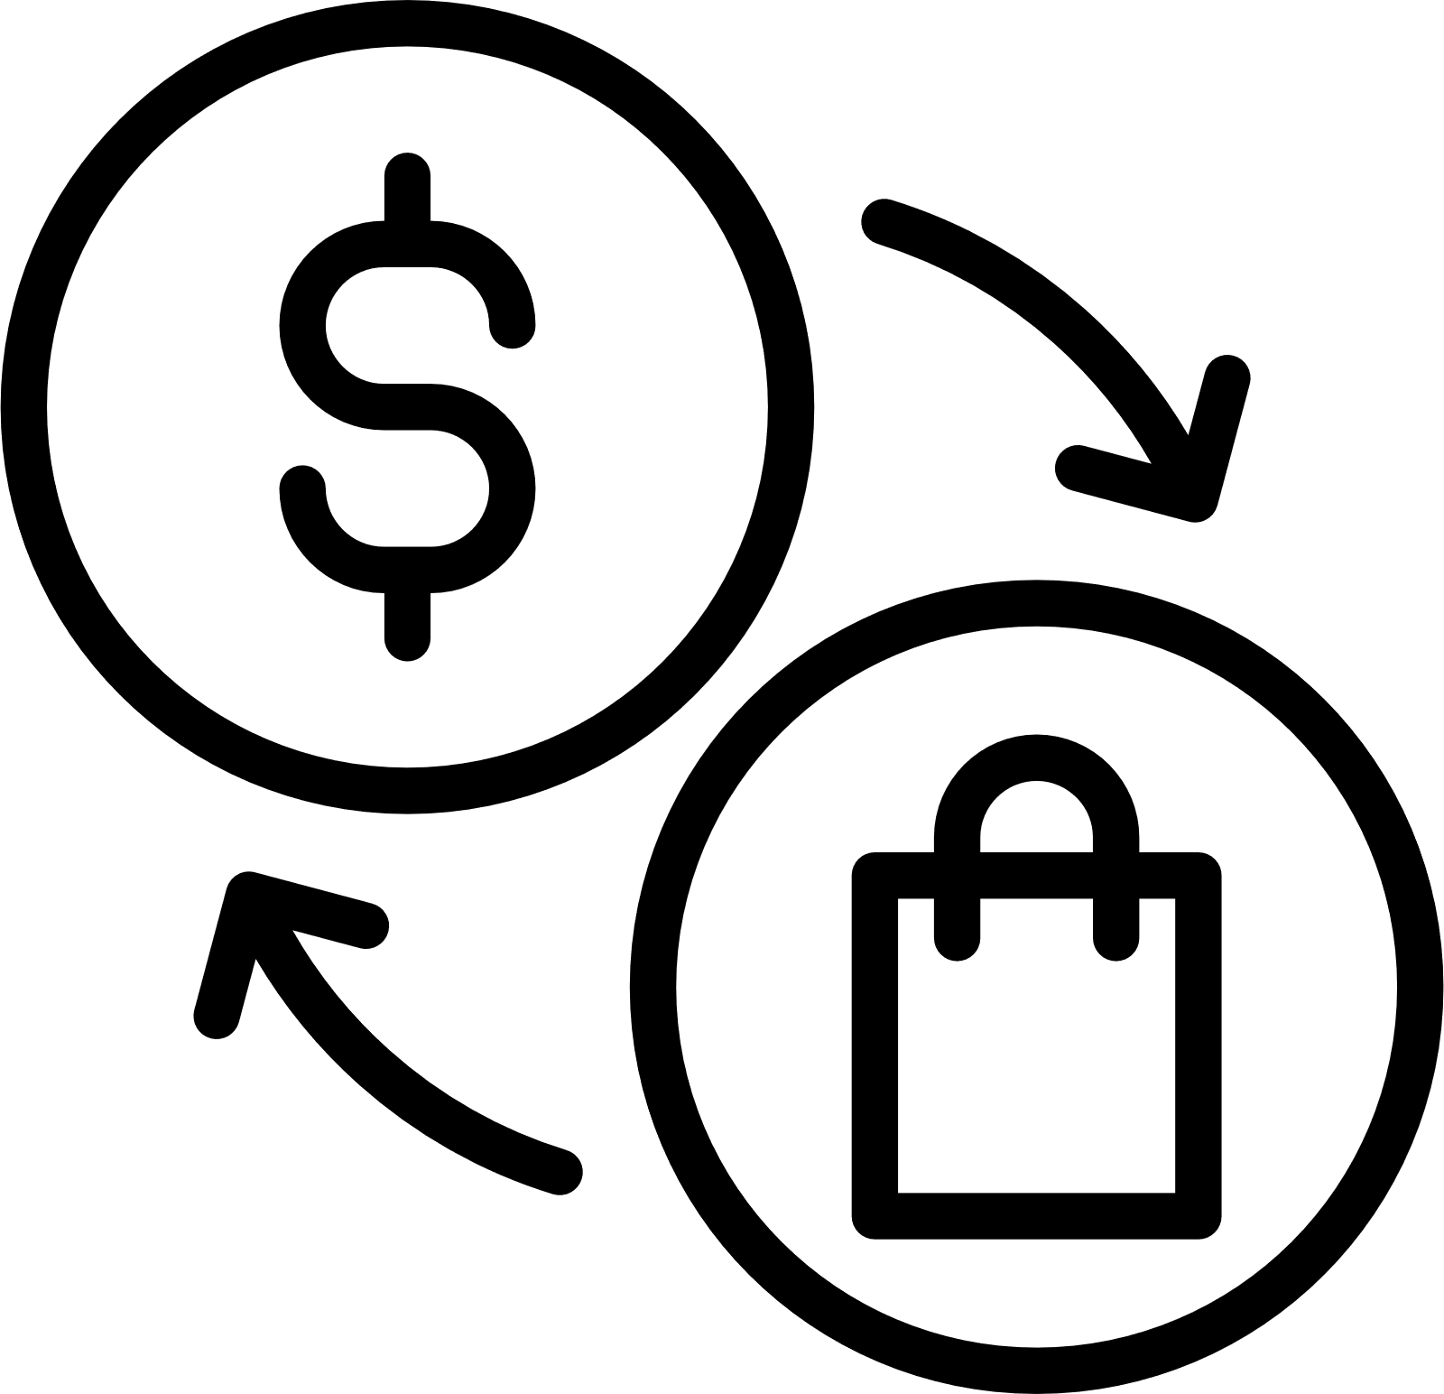





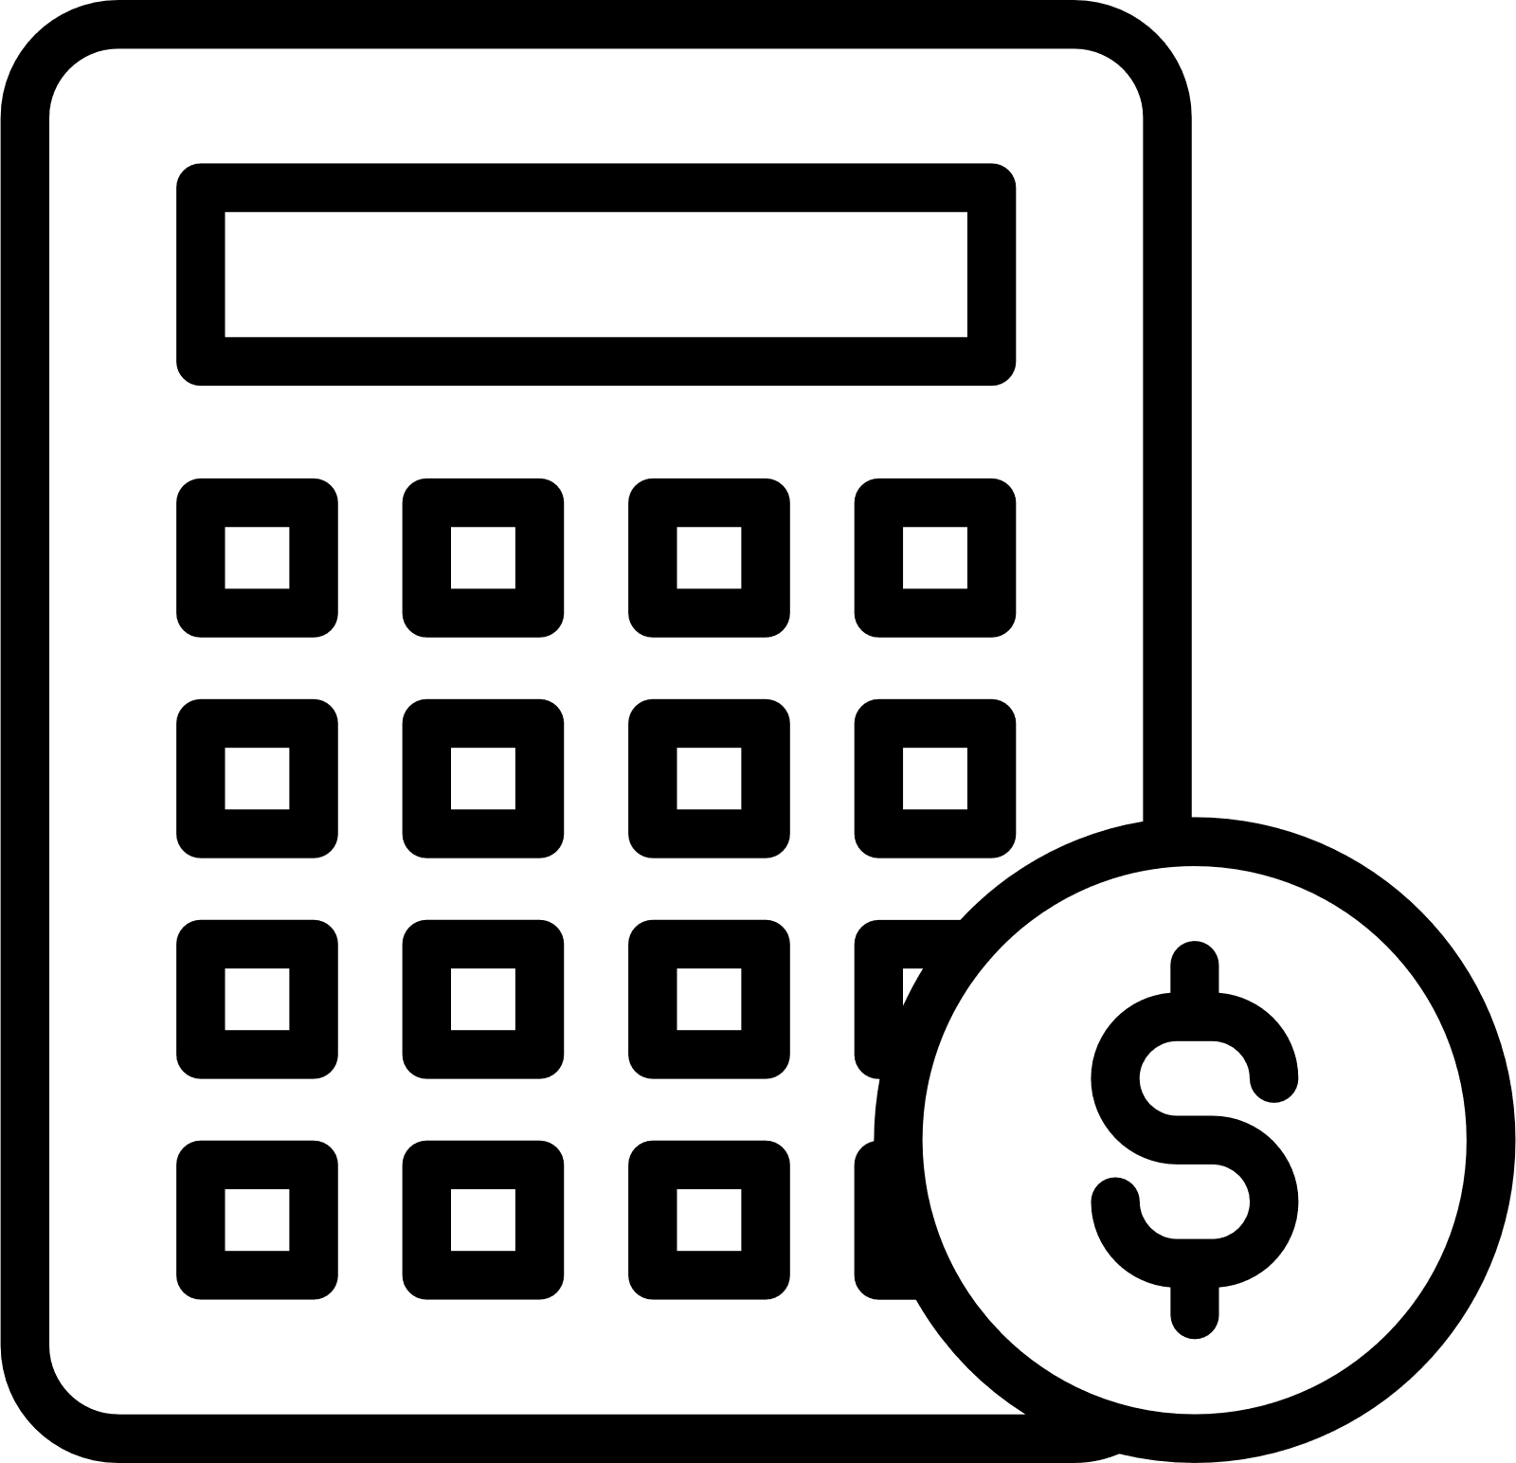





Resource Page

